Slide 1



Initial Coin Offerings
Radi Atanassov
Course Topic
SoftUni Team
Technical Trainers
Software University
http://softuni.bg

Slide 2
My Contacts
Radi Atanassov
radi@sharepoint.bg
+359878823339
Add me on Facebook ☺

Slide 3





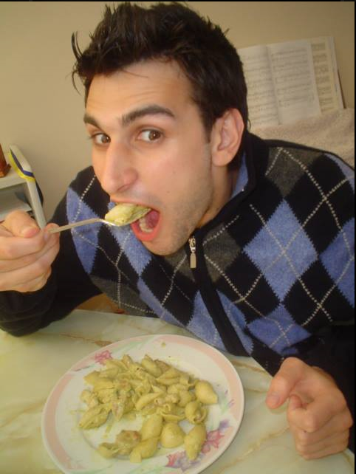


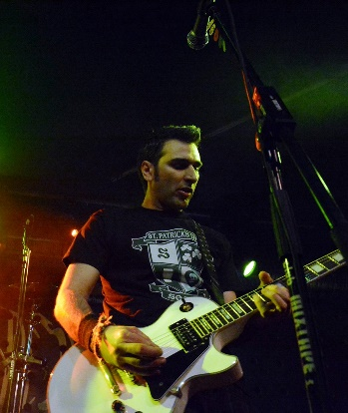


C:\users\radi>whoami
Radi Atanassov
Owner/Founder: OneBit Software
Microsoft Certified Master: SharePoint 2010
Microsoft Certified Solutions Master
Microsoft Certified Trainer
Chief Architect at OneBit Software
Senior Director at Progress
C# Developer at Rebellious Software (World of Myths Game)
Microsoft OfficeDev PnP Core Team Member
Conference speaker since 2009
Sound Engineer
Failed rock star…
Microsoft Most Valuable Professional (8th year)
Certified Scrum Master
SharePoint User Group Bulgaria

Slide 4
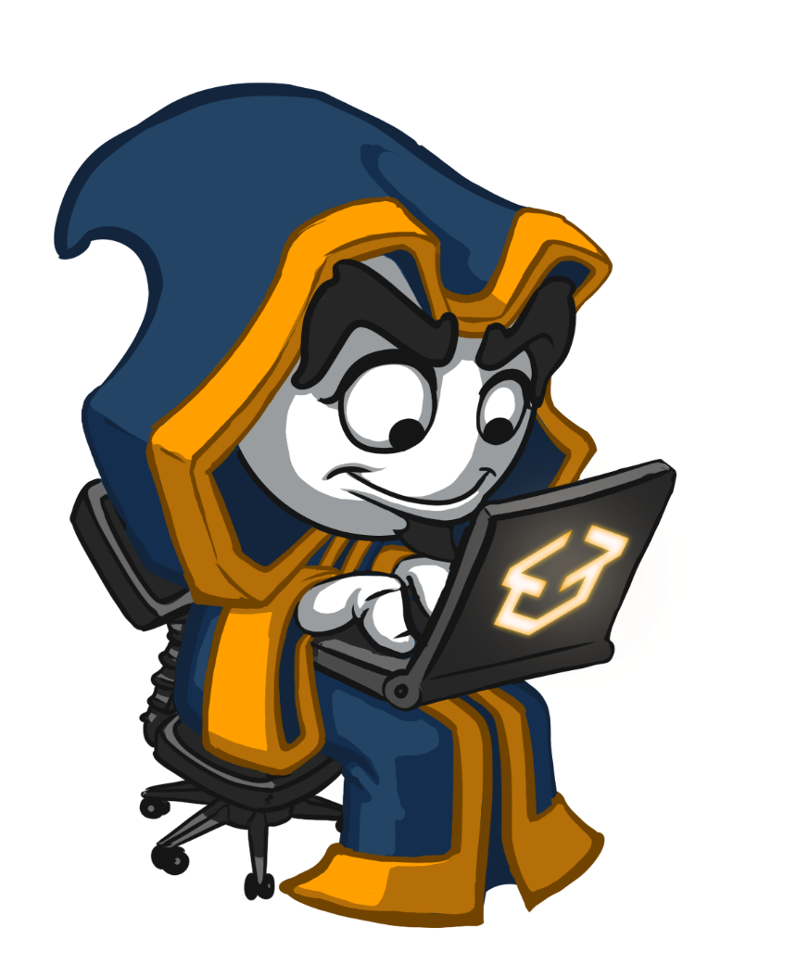
Table of Contents
ICO Overview
Marketing ICO’s
White papers

Slide 5
Session Goals
Get familiar with ICO concepts
Review good and bad ICO’s
Discuss white papers

Slide 6
Disclaimer
Do not take this session as financial advice
I am not a financial advisor
Do your own research if you plan to invest
The ICO market is extremely risky
Always be prepared to lose ALL of your money in ICO’s and Crypto-currencies

Slide 7
Questions
sli.do #B-Chain-Intro

Slide 8
Initial Coin Offerings
The new vehicle for fund-raising

Slide 9
Initial Coin Offerings
An alternative to IPO’s
ICOs aim to raise “value”
Release/issue tokens for another asset or currency
Executed on a blockchain
Designed to crowdfund project investment
Wider reach to investors (which may become users!)
Not a VC/Accelerator target model
Easy to collect “value” in the form of crypto or fiat
Usually facilitated by an ICO platform

Slide 10
IPO’s vs ICO’s
ICO
IPO
Regulation
Credibility
Rewards
Duration
Access
Not a lot
Weak
Growth
Short
Open
Very regulated
Strong history
Dividends
Long-term
Sometimes exclusive

Slide 11
Token Economy
You define your own economic model and incentive scheme
Duration
Discount
Rounds
Capped vs Uncapped
Generation logic & returns on failure

Slide 12
Profile
Skilled blockchain experts
Project believers
Informed investors
Investors with very little experience

Slide 13
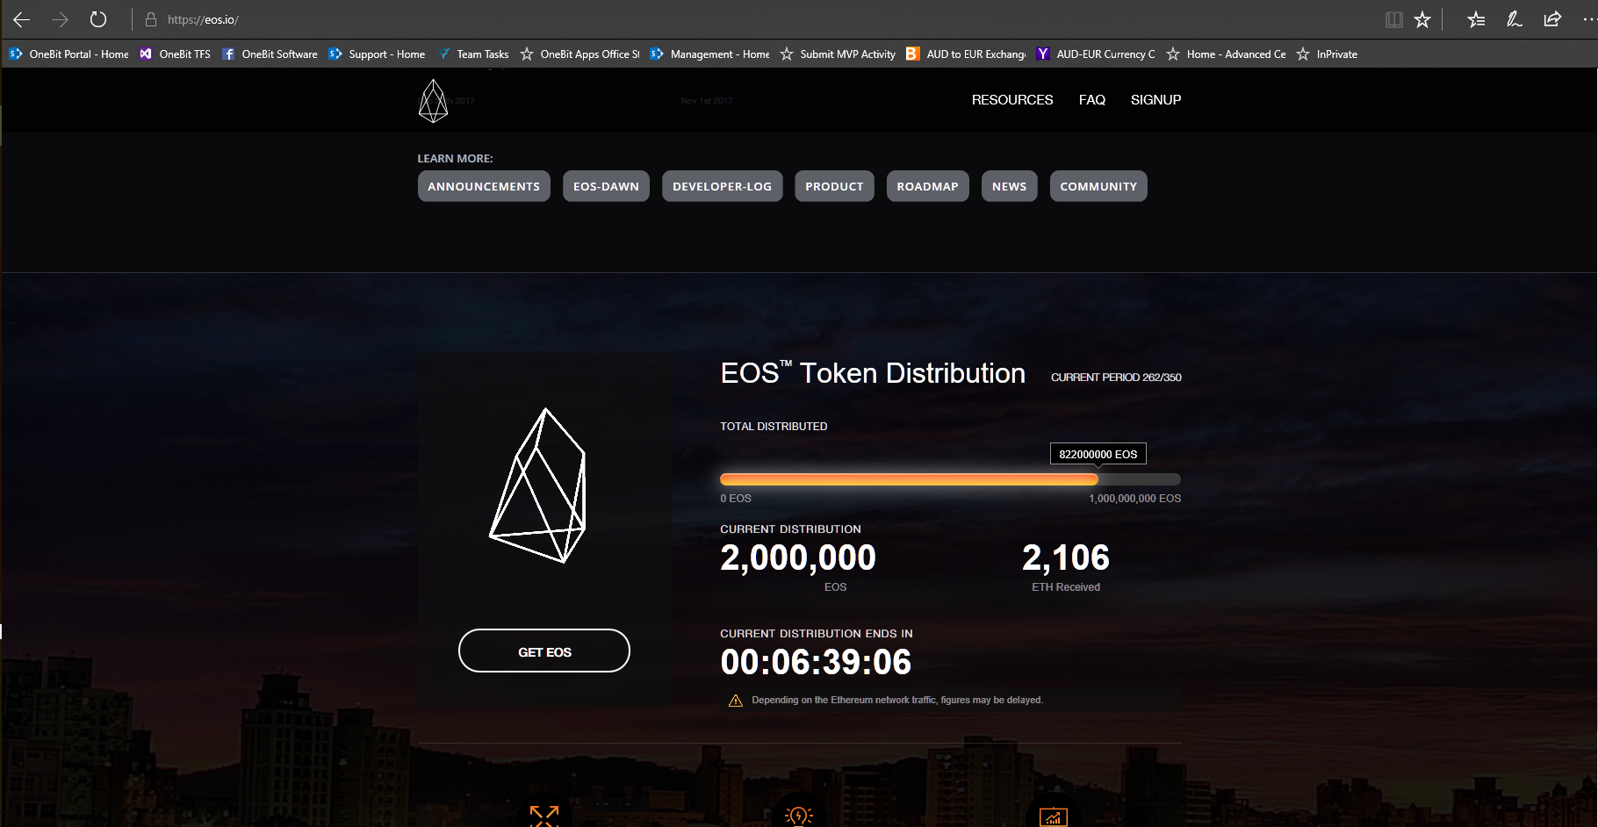

Slide 14
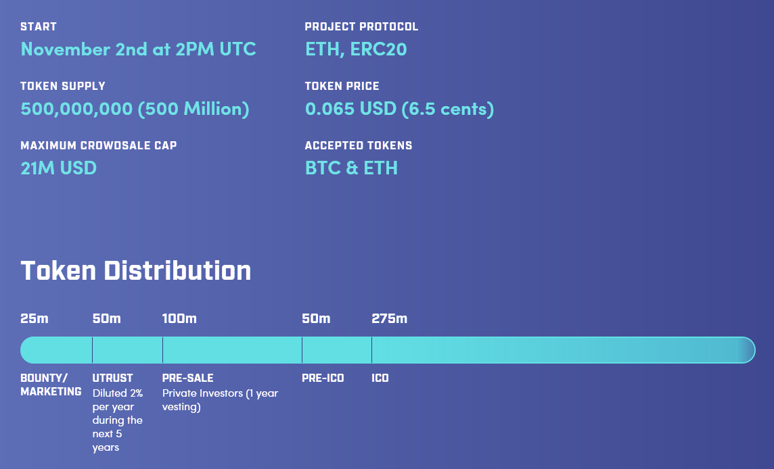

Slide 15
ICO Distribution
An important aspect of the overall message and strategy
Founders
First employees
Future Investments
Bounty Rewards
Marketing
Vesting Options

Slide 16
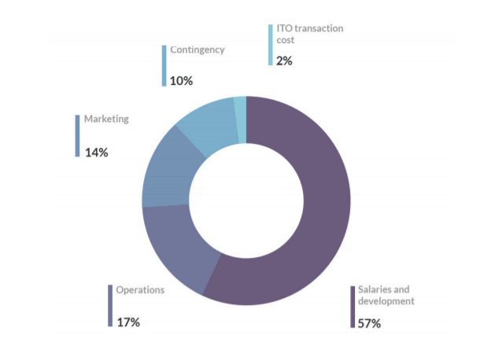
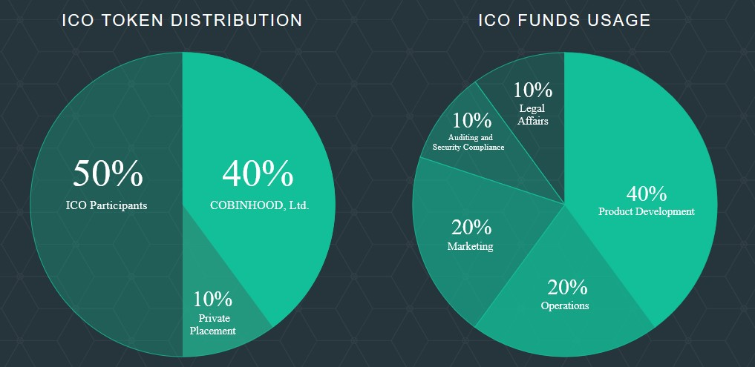
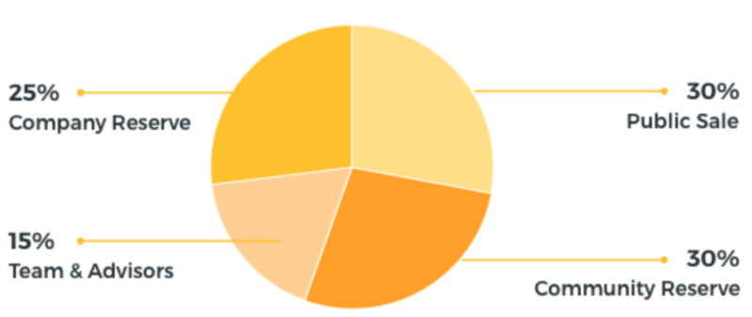

Slide 17
ICO Platforms
Ethereum with Smart Contracts
https://coinlaunch.co
https://blockstarter.co/
Indiegogo
https://coinlist.co/

Slide 18
Typical ICO steps
Create your website
Write the Whitepaper
Execute the Token on an ICO platform
List on exchanges

Slide 19
Legislation & Regulation
Very different from country to country
Governments are still trying to figure it out
Securities and Exchange Commission on violations of law
https://www.sec.gov/litigation/investreport/34-81207.pdf
Appealing countries: Bulgaria, Singapore, Estonia, Liechtenstein, Switzerland

Slide 20
Legislation & Regulation
Get a good legal team and listen to them
They must be knowledgeable about cryptomarkets and company law

Slide 21
Utility Token vs Security
Security Token
“Shares” in a business
Regulated by SEC in the US
Avoided now
Utility Token
Future access to a product or service, not ownership in a business
Used as “currency” to trade for something else
Filecoin, LockChain

Slide 22
Whitepapers
Details the project, solution, token mechanics, market, team
The main paper for building credibility
Technical vs Business
Can have more than one

Slide 23
Whitepaper writing tips
State the problem
Describe your proposed solution
Describe it’s market
Define the token economy and mechanics
Describe the money distribution
List the team and advisors
Project plan
Circulate for feedback

Slide 24
Whitepaper Examples
https://www.monetha.io/Monetha_WP.pdf
https://www.aeternity.com/aeternity-blockchain-whitepaper.pdf
https://github.com/ethereum/wiki/wiki/White-Paper
https://coss.io/documents/white-papers/iconomi.pdf
https://www.cryptokitties.co/Technical-details

Slide 25
After the ICO…
The ultimate goal is to list the token on exchanges
Can cost lots of money
The price will fluctuate based on the market
Volume is very important
Executing the project plan and marketing plan is the key priority

Slide 26
Scams
ICO’s with malicious intent
Gather your crypto and run
Detect them by:
Unrealistic goals, lots of buzzwords, a bad whitepaper, no code repository or a very bad one
Evaluate and trace the team
No escrow
No news
Fake pictures
Prior funding?

Slide 27
ICO Hacking
Fake e-mails and other social engineering techniques
Social posts to alternative addresses
Attacks at the IT level
Keep security very high

Slide 28
Marketing & Community
More than a full-time job…

Slide 29
ICO Marketing
The crypto version of “pitching” to investors
High reach is your key goal
Target audience
Most ICO’s do well only due to hype
Some perform pre-ICO hype
Have a marketing calendar!

Slide 30
Project Community
Your pool of investors and users
24/7 communication
Direct access to developers
Deal with trolls
Give them constant support

Slide 31
Project Website
Extremely important as the go-to place for all marketing
Video
Link to Whitepaper
Team
Project Details
ICO Details
https://www.gilgameshplatform.com/
https://filecoin.io/
https://eos.io/
https://tokenstars.com/team

Slide 32
Facebook Ads
Banned on January 30, 2018
“We’ve created a new policy that prohibits ads that promote financial products and services that are frequently associated with misleading or deceptive promotional practices, such as binary options, initial coin offerings and cryptocurrency.”

Slide 33
Google Ads
Upcoming ban
https://www.coindesk.com/canadian-official-wants-google-ban-ads-crypto-icos/
https://cryptonews.com/news/google-to-ban-ico-and-crypto-ads-source-1366.htm
https://www.financemagnates.com/cryptocurrency/news/exclusive-google-quietly-purging-cryptocurrency-ads-content/

Slide 34
Telegram
Chat with the project team
just a messaging app with some cool features
Considered critically important
24/7, usually ran by “Community Managers”

Slide 35
Medium
Social content platform
Amateur and professional people can publish content
Very popular in the crypto community

Slide 36
Others
HackerNews
LinkedIn
Indie Hackers
E-mail marketing
Conferences

Slide 37
Interesting Telegram Channels
SmartContracts — channel with news about blockchain and ICO
Thecointelegraph — the official channel about Cointelegraph media about Fintech, Blockchain and Bitcoin
Preicoved — listing of Pre-ICO and Pre-sale crypto projects
ICO, Blockchain, Startups — group of investors, experts and entrepreneurs, discussing the regulatory issues, insightful news and trends of blockchain and crypto market and analysing ICO startups.
Cryptocurrency — telegram channel posting news about cryptocurrencies (mostly from Cointelegraph) and upcoming ICOs (rarely)
CryptoCommunities — listing of global crypto communities in telegram
Bitnationchat — Telegram presence of the Bitnation community

Slide 38
Reddit Subreddits
BlockChain — all the stuff about blockchain
Blockchain Startups — dedicated subreddit for blockchain startups
CryptoCurrency — all subjects related to emerging crypto-currencies and crypto-assets
Icocrypto — the place to come for discussion of everything related to active and upcoming ICO / Crowdsales
ethtrader — Ethereum news, memes, investing, trading, miscellaneous market-related subjects and other relevant technology.
ICOAnalysis — a place to analyse cryptocurrency ICO companies.
CryptoICO — ICO listings, information and discussions
InitialCoinOfferings — discussions related to ICO, Crowdsales and Token sales in the fields of Blockchain and Datachain
Best of Crypto — this subreddit is for sharing and archiving the best comments regarding cryptocurrency within Reddit
IcoCrypto — Discussions related to ICO, Crowdsales and Token sales in the fields of Blockchain and Datachain

Slide 39
Conclusions
You need full time marketing and PR
The community is your true hype driver
Get an ICO consulting firm if you are serious

Slide 40
Summary
ICO’s raise value through cryptocurrencies to fund projects
It is all about constant marketing!
Whitepapers are very crucial to the success of your ICO

Slide 41
Homework
Read the CryptoKitties whitepaper.
How many “Gen 0” cats we’re conceived at the launch?
Does the CryptoKitties project have a token?
Do you receive any rights when you purchase EOS tokens?
Describe several highlights of the EOS token distribution process.

Slide 42







https://softuni.bg/courses/

Slide 43

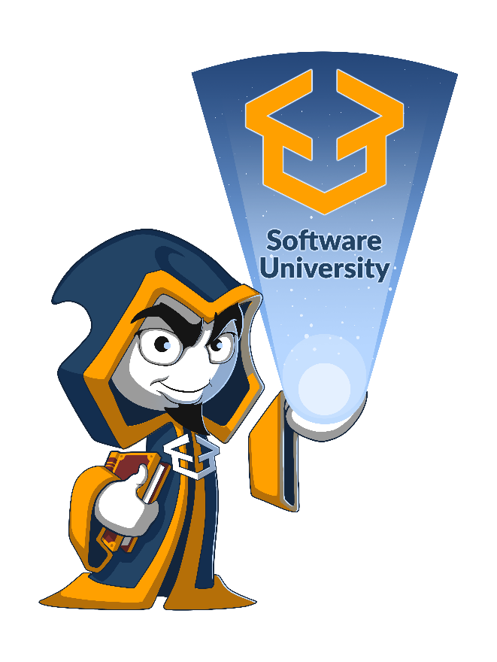



Trainings @ Software University (SoftUni)
Software University – High-Quality Education, Profession and Job for Software Developers
softuni.bg
Software University Foundation
http://softuni.foundation/
Software University @ Facebook
facebook.com/SoftwareUniversity
Software University Forums
forum.softuni.bg

